Slide 1
Big Data Introduction

Slide 2
Big Data Use Cases
A
Incident Predictability
Product Feature Predictions
Airline Maintenance
Retail Analytics
Genomics
B
AWS Data Lake – Data Pipeline
Forecasting FW Samples
Manufacturing IOT

Slide 3
Agenda / Topics
Big Data Intro
Map Reduce
Hadoop
NO SQL
Hive
HBASE
FLUME
SQOOP

Slide 4
Thoughts from the Instructor
Big Data Engineers / Developers / Data Analysts Expectations
One technology / language is not enough anymore
Dev Ops / Code Management / Release Management
Thorough knowledge of eco system / environment / infrastructure
Thorough understanding of data pipeline / data types
Understanding of micro services and its architecture
Understanding of cloud and its eco system
Understanding of Advanced Analytics and its applications
Good News
Cloud opens up a whole new set of opportunities

Slide 5
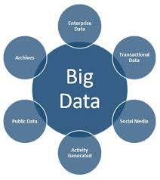
BIG DAT INTRO

Slide 6
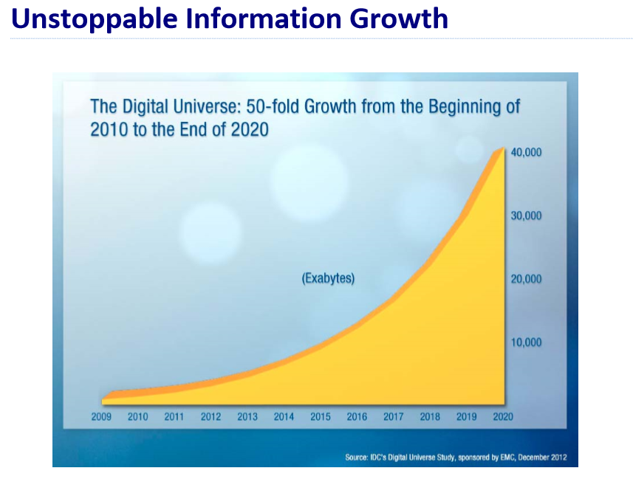

Slide 7
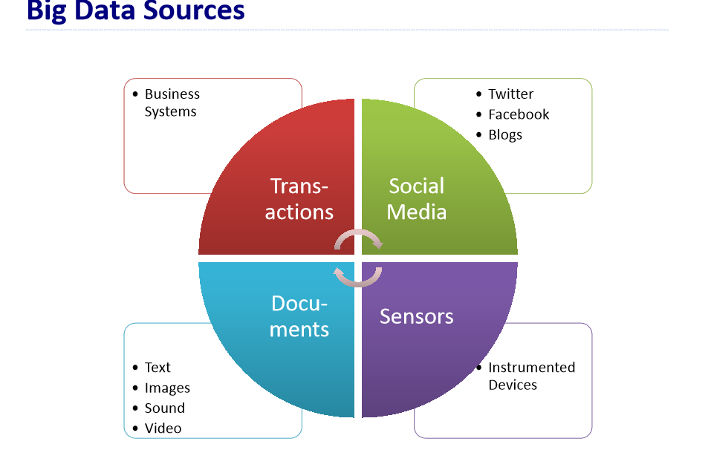

Slide 8
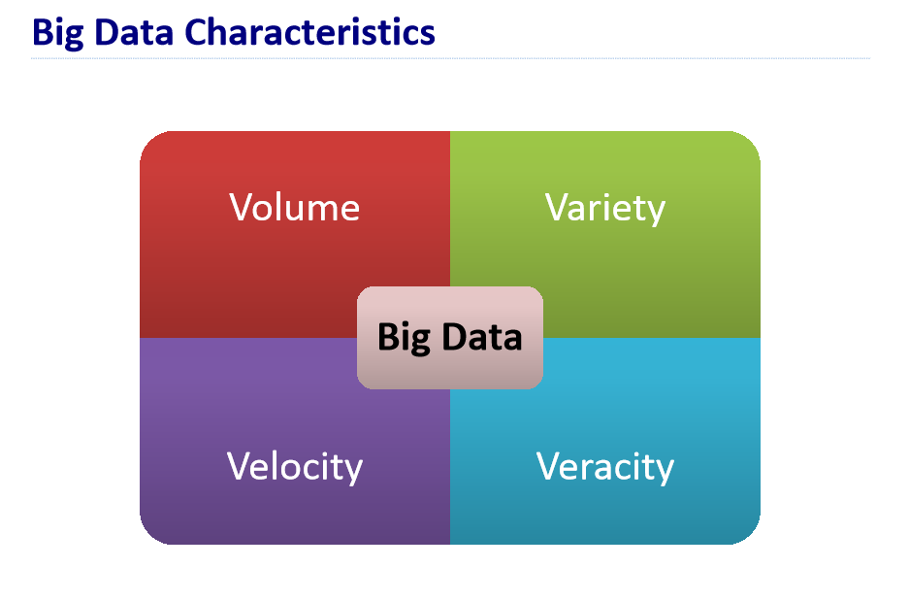

Slide 9
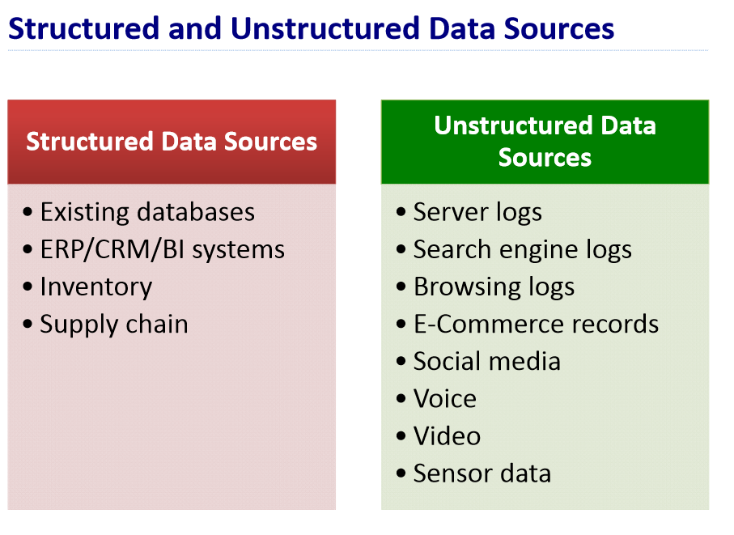

Slide 10
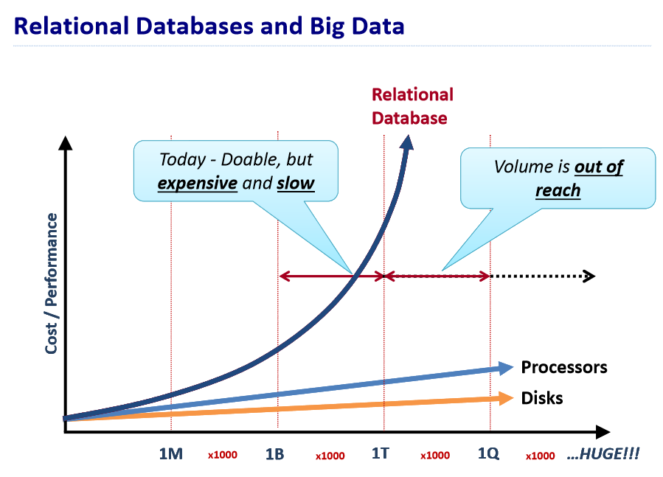

Slide 11
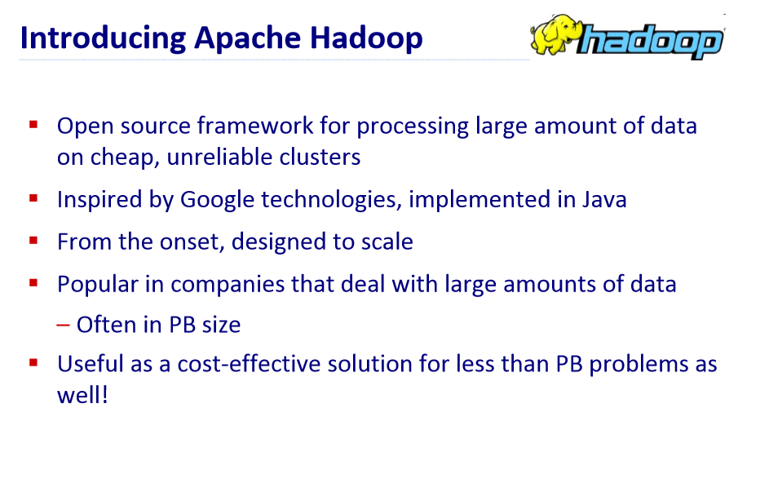

Slide 12
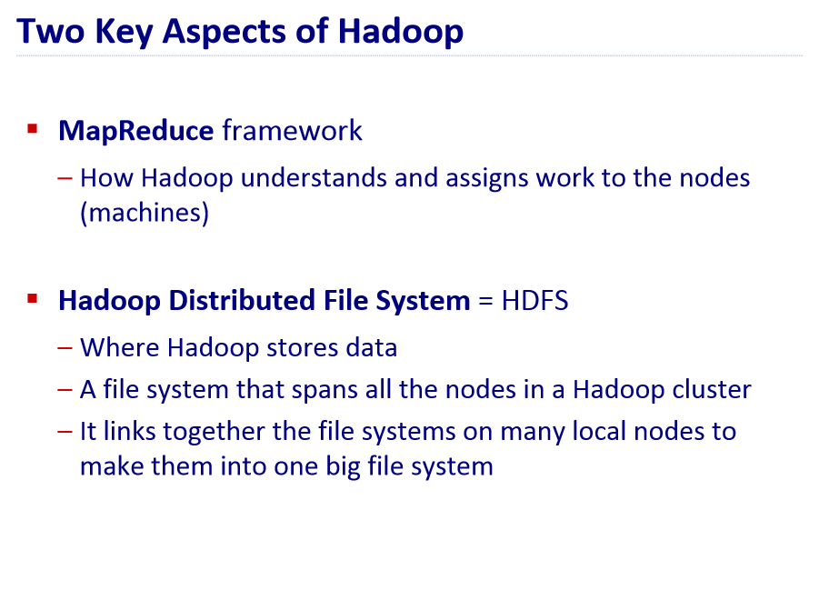

Slide 13

Different Distributions

Slide 14
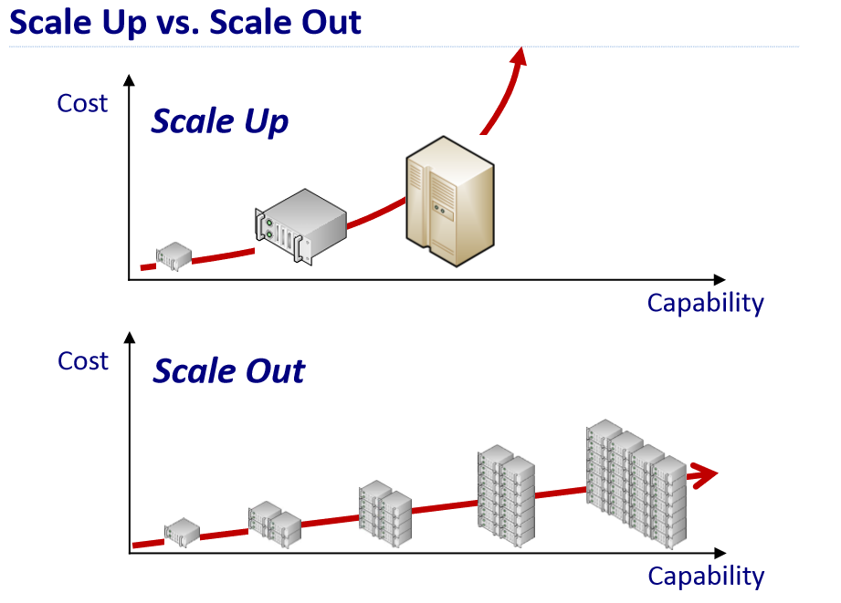

Slide 15
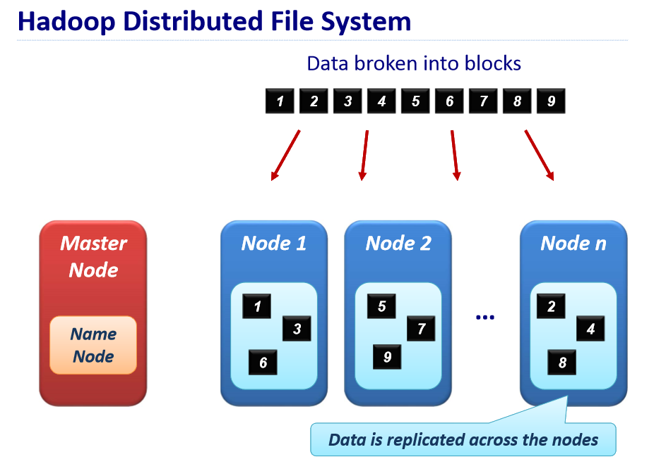

Slide 16
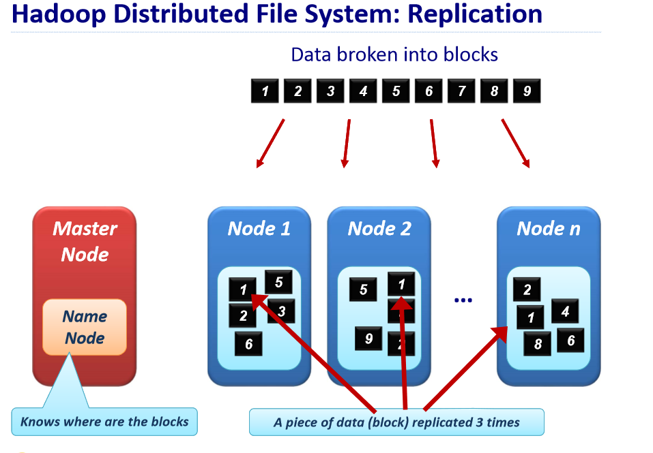

Slide 17
Immutable Data
Data stored in HDFS is immutable
Typically has Load Once – Read Multiple type of an architecture

Slide 18

Hadoop

Slide 19
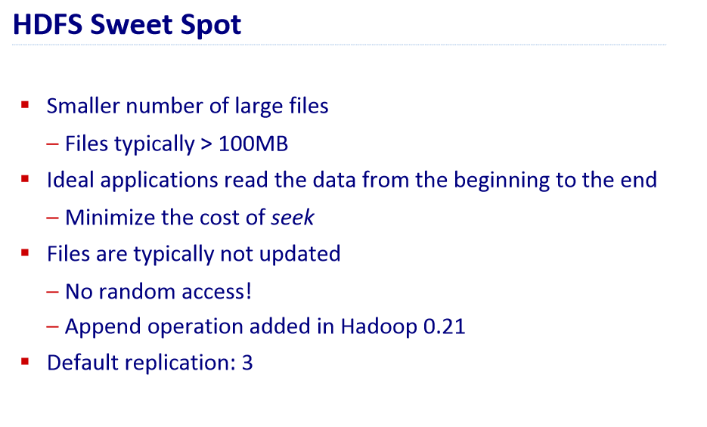

Slide 20
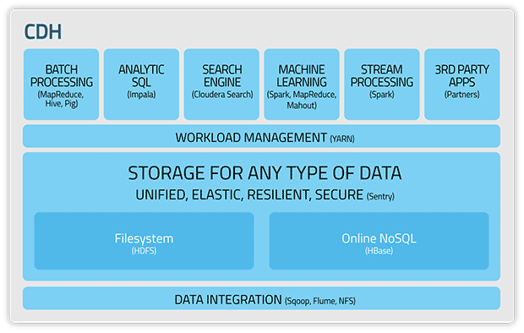

Slide 21
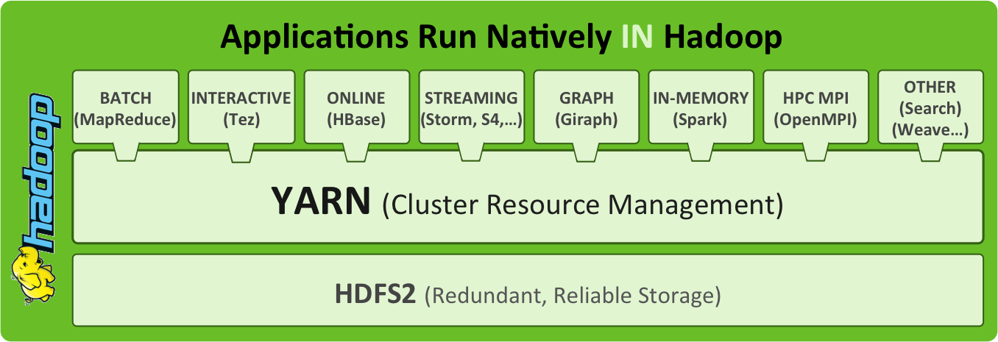
Framework

Slide 22
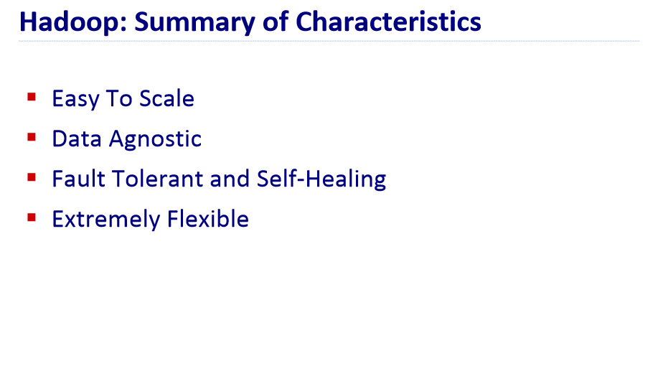

Slide 23
Typical Use Case Example

Slide 24

PROJECT GOAL
Create a Predictive Model that will allow problem managers to predict support tickets before they get reported,
By correlating automatic client generated logs and support tickets
What if we knew about tickets at an error level of detail? Can we fix them even before they arrive at the Service Desk?

Slide 25
HYPOTHESIS
Ho: Is it possible to predict Incidents from Event Logs?

Slide 26
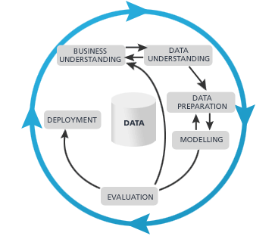
CRISP DM
Cross Industry Standard Process for Data Mining
Big chunks of time on:
Business and Data Understanding project.
Data Preparation.
All models are wrong, some maybe helpful.
Notes:
CRISP DM – Cross Industry Standard Process for Data Mining

Slide 27
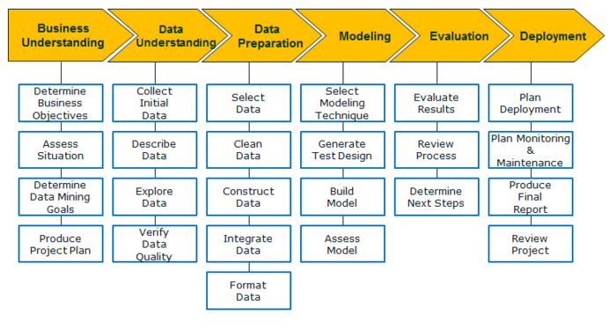
CRISP DM

Slide 28


STEPS @IP
Incidents:
We define incidents as “issues” such as system and application errors, malware infections, and other problems that disrupt normal use. Client systems account for approximately 80 percent of total enterprise incidents, making them the primary contributor by volume to overall incidents and a high priority target for IT cost savings.
Events:
Events are logs recorded by client event log system. These logs record events for everything from the failure to start a component to the failure to complete an action. Events are categorized as critical, error, information, and audit.
To use a medical analogy, incidents are like specific patient complaints and daily event logs are like comprehensive lab reports detailing everything potentially wrong in a blood sample. An accurate diagnosis generally requires both.
Machine crying for help (VOM)
Humans crying for help (VOC)
vs

Slide 29
STEPS @IP
The Challenge to proactively analyzing event logs is that event log data can amount to approximately 2,000 logs per day per machine with an average of 40 critical events. This can total up to 19 million events per day.
POC: From REACTIVE mode to PROACTIVE mode.
We started the project on SQL and suddenly migrated to BIG DATA when V’s (Volume, Velocity and Variety) were critical.

Slide 30

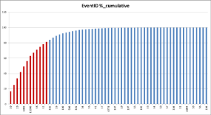


DATA PREPARATION FOR MODELING
Reducing COMPLEXITY
Introducing the “Symptom” concept we were able to reduce problem complexity from more than 22 million events to less than 135K symptoms.
Events
Incidents
eventIDs
More than 80% of event data is grouped using only 10 event IDs .
1000
30
29
300
8002
2005
302
11002
This is a way to look into events we didn’t have before…
[Intel IT Problem Manager]
Selection of critical fields by event ID to facilitate Problem Managers look into data
Symptom table
Attr1 | Attr2 | … |  | Att10
Symptoms are based on group of events.

Slide 31
DATA PREPARATION FOR MODELING
Events (WEF)
Incidents (ITSMR)
Similarity Metric
CI (Configuration Item)
JAVA
OPEN NLP
HIVE
Load into HDFS
Text Analytics
How similar are related incidents and events?
Tokenization
Roots
Stop-words
Stemming
Synonyms
Model Forecast based on Symptoms
*Other names and brands may be claimed as the property of others
Notes:
Volume: 500GB/Month --- 6 TB / Year

Slide 32
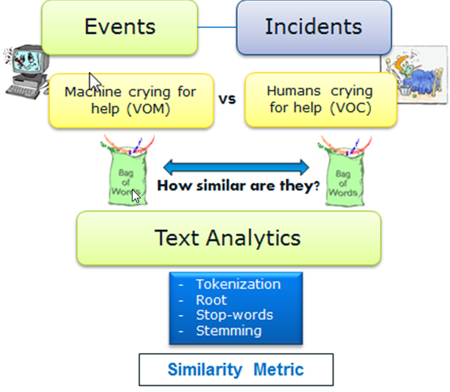
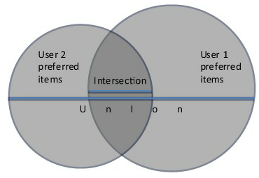
DATA PREPARATION FOR MODELING
Jacquard Similarity
The Jacquard similarity coefficient measures the similarity between two sample sets (A and B) by dividing the size of the intersection (in this case, the number of times an event log and an incident report use a common word) by the total of words in both sets.

Slide 33
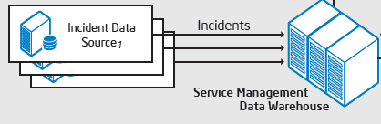
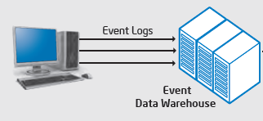
DATA SOURCES
VOICE OF THE CUSTOMER
Consists of clients issues reported by Intel employees primarily through IT Help desk
XX Volume
VOICE OF THE MACHINES
Includes all event logs generated by client-machines daily
YY volume

Slide 34
RDBMS versus BIG DATA
Project was initially deployed on traditional RDBMS DB
Analytics was initially implemented using open source RapidMiner™ tool
Challenge: 1 cycle process took several days to complete
We decided to move to Big Data using Java, OpenNLP and Hive
Volume: we are talking about millions of incidents and hundred-of-millions of events. Combination of these incidents – events growth exponential and volume becomes a problem.
Velocity: process became slow due to data volume and similarity metrics computation taking a lot of time.
Variety: unstructured data by nature (<XML>) data.

Slide 35
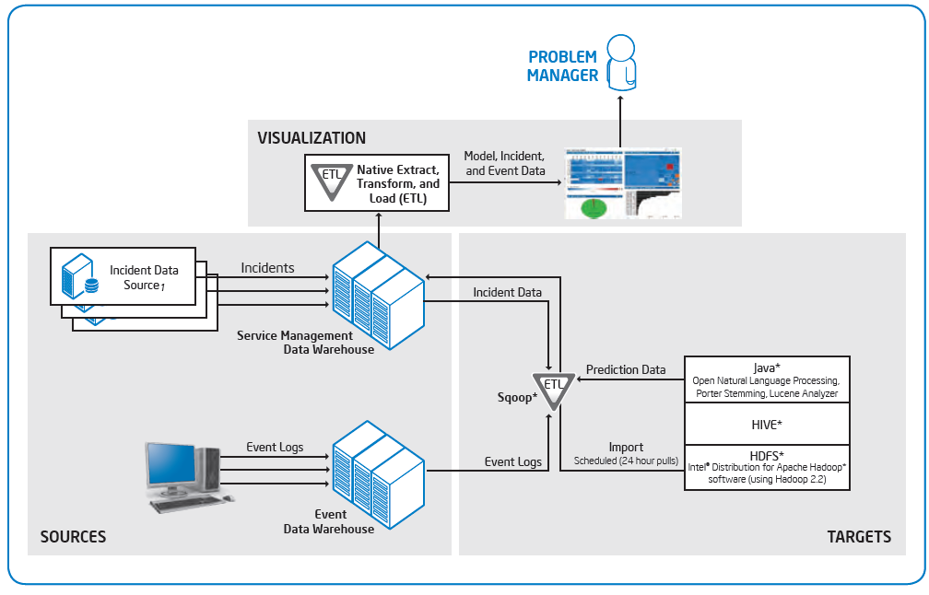
SOLUTION ARCHITECTURE

Slide 36

NO SQL (Not Only SQL)

Slide 37
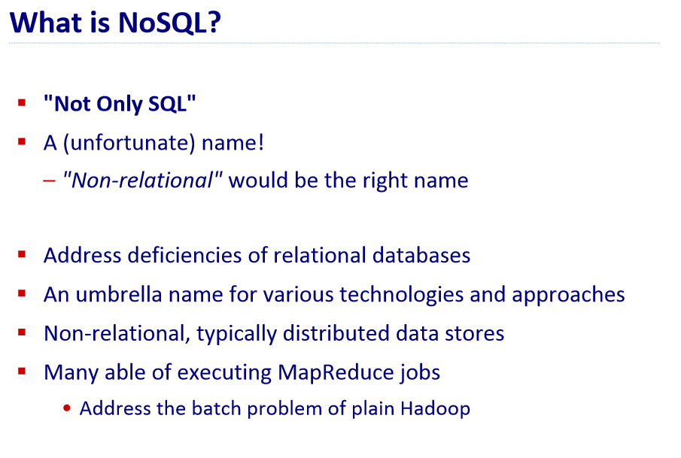

Slide 38
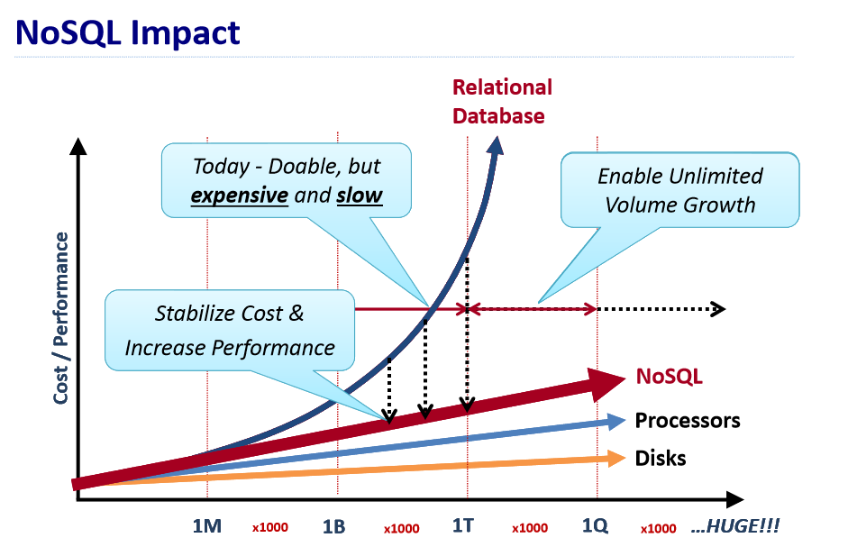

Slide 39
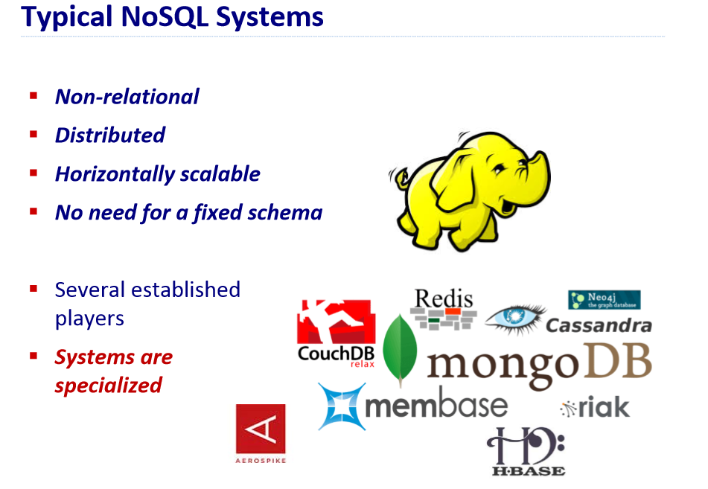

Slide 40
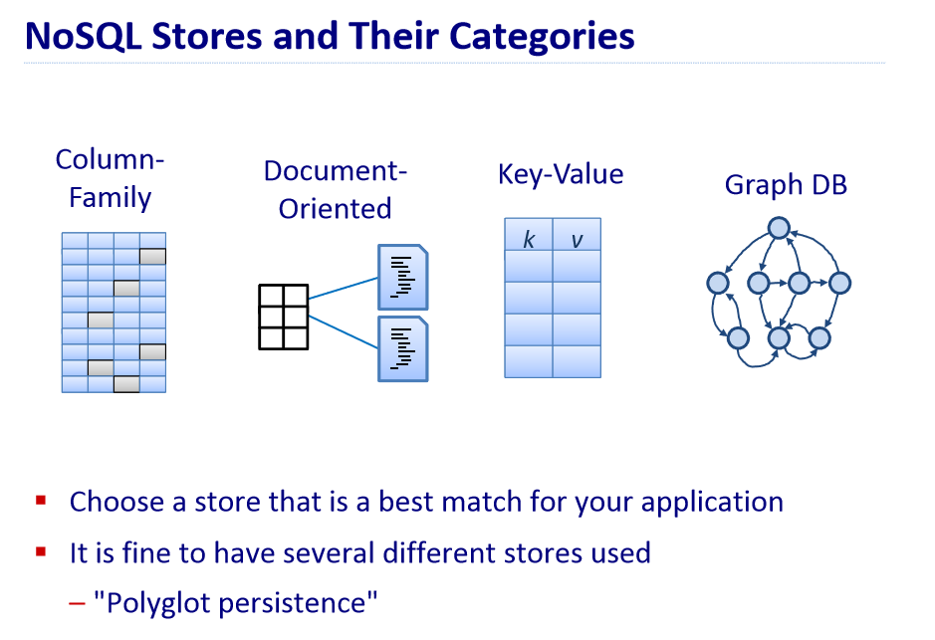

Slide 41
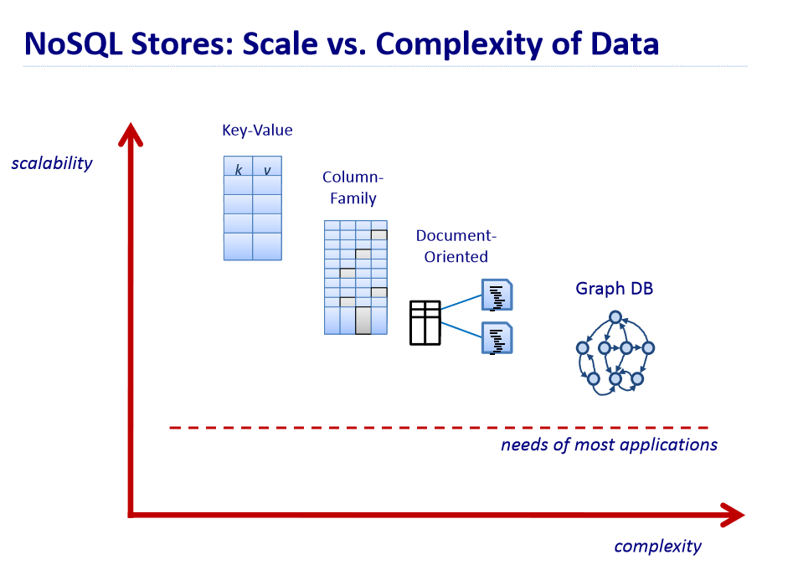

Slide 42
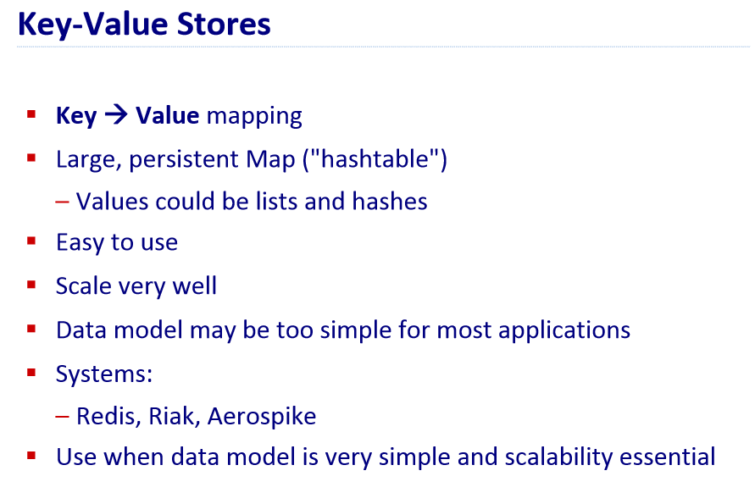

Slide 43
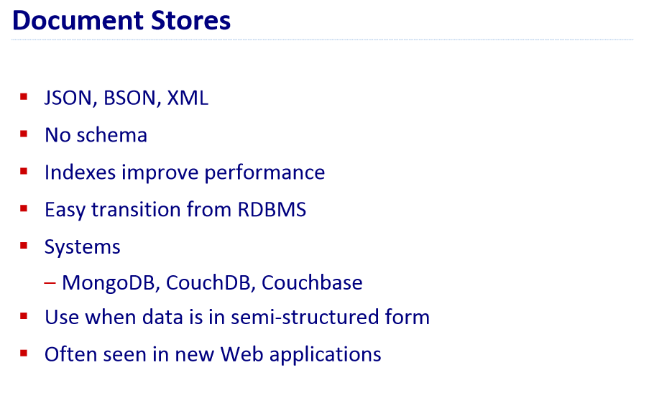

Slide 44
Quiz - Q&A
What is NO SQL?
What are the different types of NO SQL Databases that are out there?
Name at least 3 NO SQL databases in the market today?

Slide 45
HIVE

Slide 46
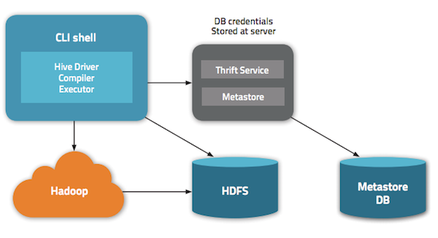

Slide 47
Quiz - Q&A
Why Map / Reduce?
What is HDFS?
Name at least 3 Hadoop Distributions?
Name at least 3 tools of Cloudera Hadoop Distribution (CDH)?
Name 2 storage systems of CDH?
Name the 2 batch processing tools in CDH?
Name 2 Machine Learning tools in CDH?

Slide 48
HUE (Hadoop User Experience)

Slide 49
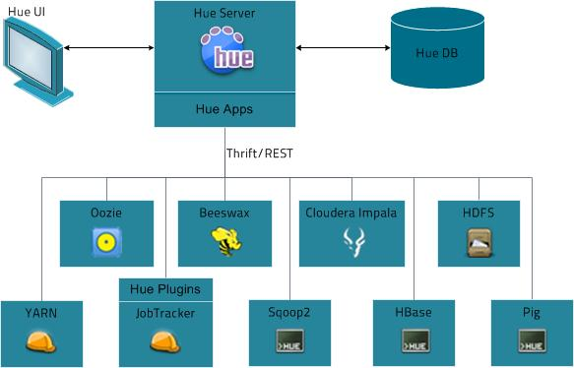

Slide 50
Quiz - Q&A
What is HUE?

Slide 51
HBASE

Slide 52
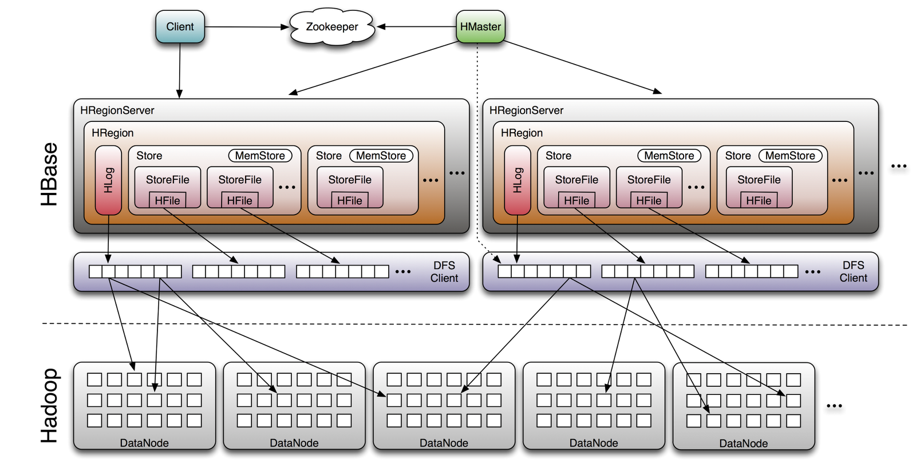

Slide 53
Quiz - Q&A
Why Map / Reduce?
What is HDFS?
Name at least 3 Hadoop Distributions?
Name at least 3 tools of Cloudera Hadoop Distribution (CDH)?
Name 2 storage systems of CDH?
Name the 2 batch processing tools in CDH?
Name 2 Machine Learning tools in CDH?

Slide 54
FLUME

Slide 55
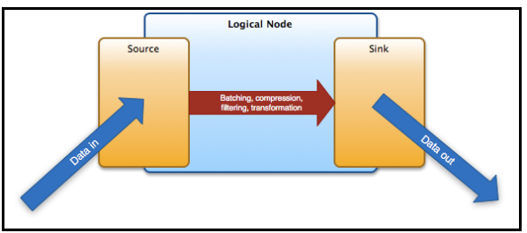
Flume Work Flow

Slide 56
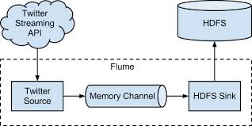
Example Flume

Slide 57
SQOOP

Slide 58
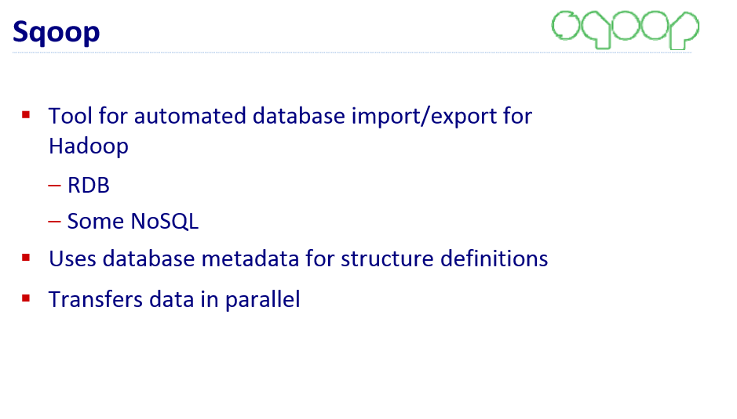

Slide 59
Quiz - Q&A
What is Flume?
How is Flume Useful?
What is Sqoop?
How is it useful?
Difference between Flume and Sqoop?

Slide 60
OOZIE

Slide 61
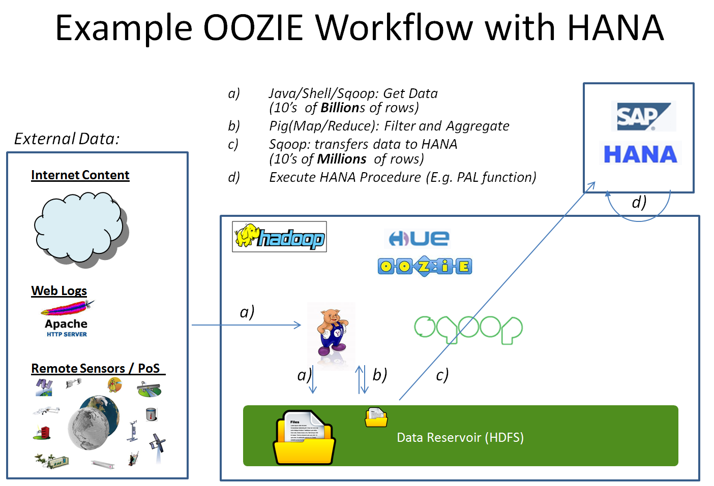

Slide 62
Big Data Methodology

Slide 63
CRISP DM
Cross Industry Standard Process for Data Mining
Iterative and repetitive methodology
First round of data understanding, data preparation and modeling was done as simply and as quickly as possible
Data Scientists started statistical Modeling as soon as the sample set of data and the simple secure small data system was in place
very crucial for us to enable the data scientists as soon as possible

Slide 64
CRISP DM

Slide 65
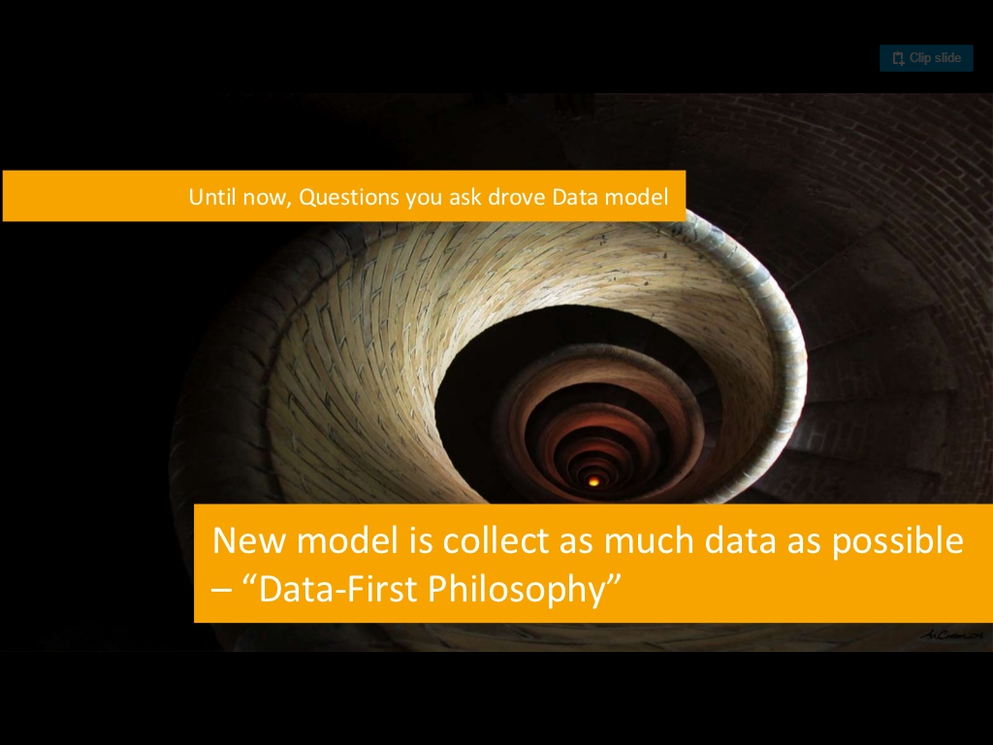

Slide 66
How the Cloud
Is a Big Data’s
Best Friend?

Slide 67
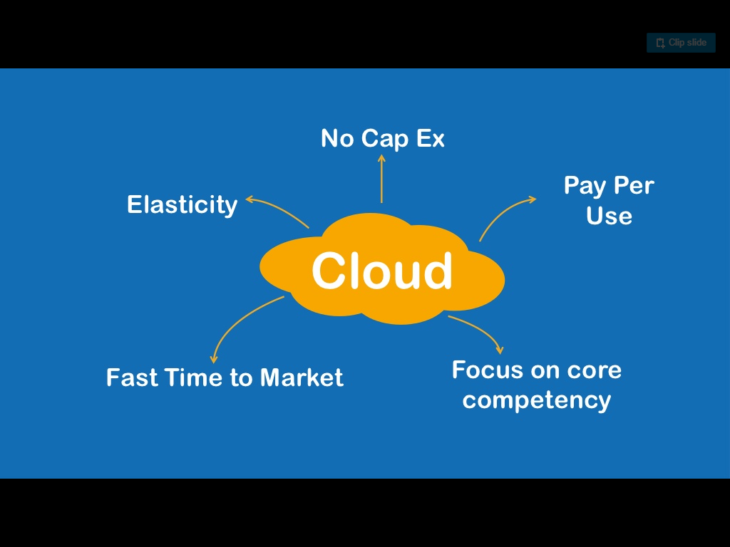

Slide 68
Cloud Reduces
Cost
For Experimentation

Slide 69
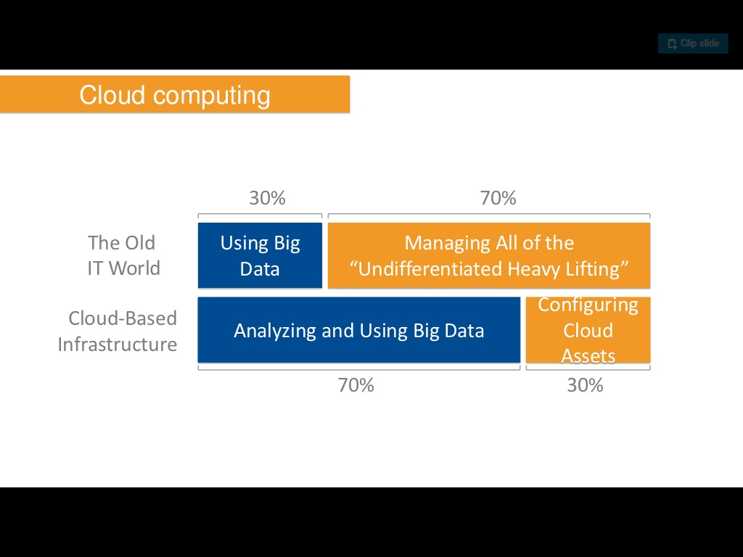

Slide 70
Cloud Optimizes
Capacity Resources

Slide 71
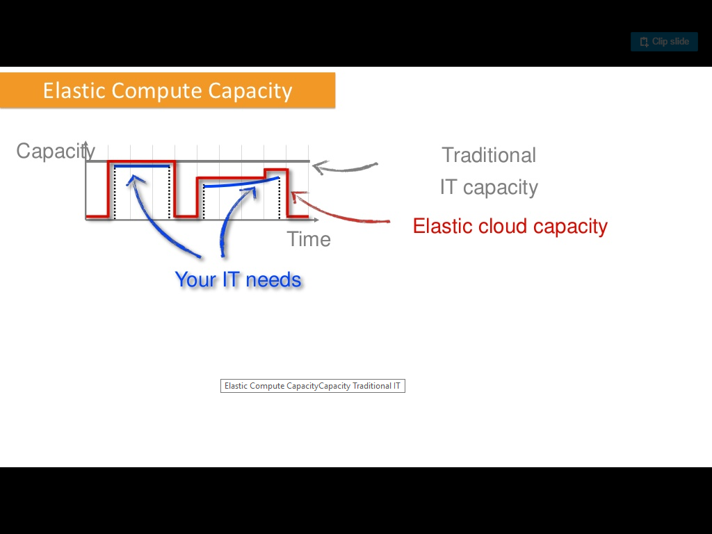

Slide 72
Empowers user to
Balance cost & time

Slide 73
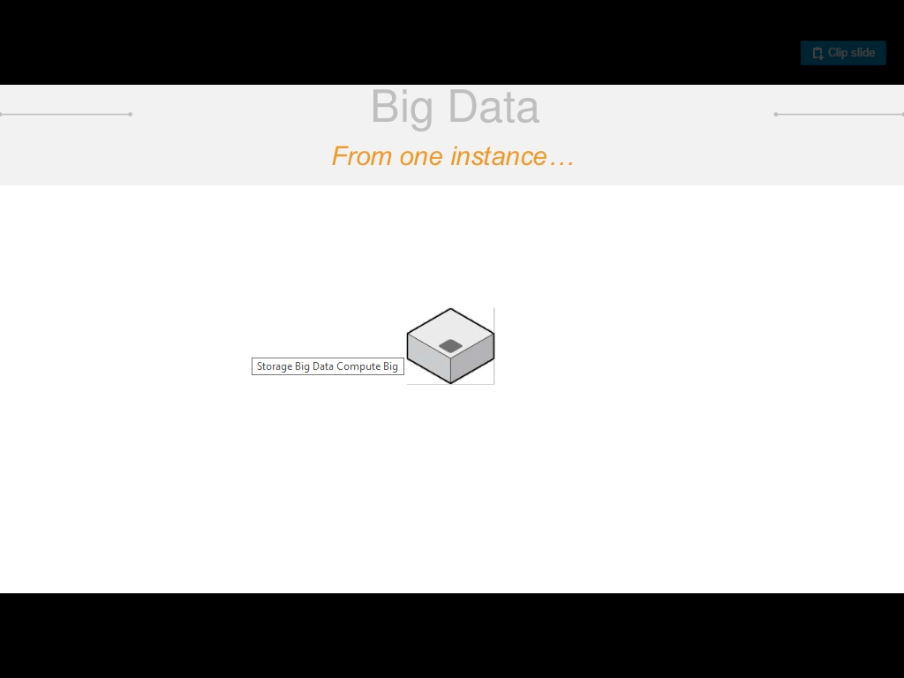

Slide 74
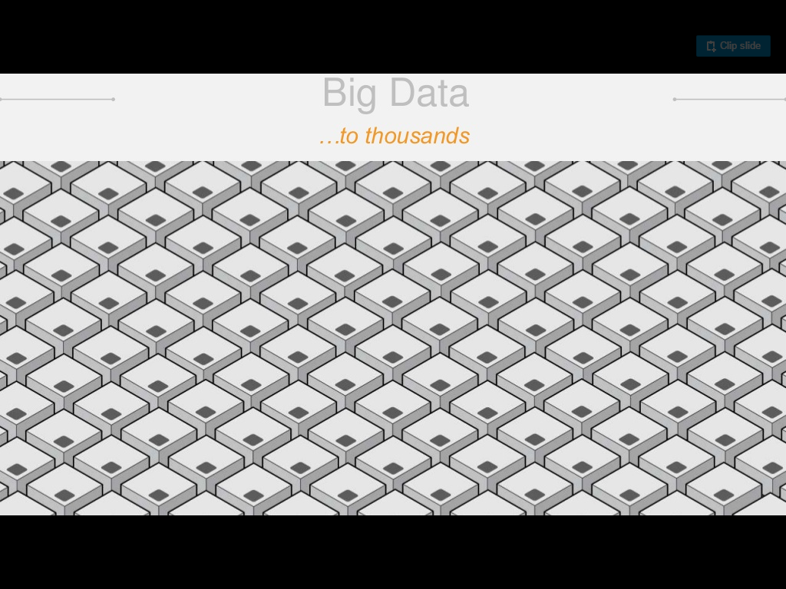

Slide 75
Cloud Scales

Slide 76
Big Data - Data Lake and Cloud

Slide 77



KEY FOCUS: SECURITY
Established direct connect
Built Virtual Private Cloud
Data Transition using SSL
Encrypted Data at Rest

Slide 78
ENABLED DATA SCIENTISTS
Data Scientists worked on Sample Sets of data
< 10 – 20 GB
Non Clustered
ELB ec2 Nodes
Simple tools like R Console, Python
Interactive tools like R-Studio, Jupyterhub
Data Scientists and Architects worked on bigger data sets
< 6 – 8 TB
Clustered
Distributed tools like SparkR, PySpark
Interactive tools like Jupyterhub
Data Scientists and Architects worked on full data sets
Burst capacity in nature
Clustered
Distributed tools like SparkR, PySpark
Interactive tools like Jupyterhub
Secure Small Data Systems
Clustered Development Systems
Clustered Production Systems

Slide 79
BATCH PROCESSING WAS ESSENTIAL
Clustered Development Systems
Essential for ETL / Prepping, Cleaning, Munging the data
< 10 – 12 TB
Clustered
Distributed tools like Hive, Pig & Java M/R
Interactive tools like Oozie workflows
Clustered Production Systems
ETL / Prepping, Cleaning, Munging on full datasets
Burst capacity in nature
Clustered
Distributed tools like Hive, Pig & Java M/R
Interactive tools like Oozie workflows

Slide 80
Auto Scaling vs Elastic Map Reduce
Auto Scaling
Tried AWS Auto scaling, the rules set at the infrastructure level was helping development jobs to spin up more nodes
Auto scaling was hard to set at the job level
Elastic Map Reduce
Auto scaling could be controlled at the job level
If all rules are known, it was easy to setup burst capacity EMR jobs

Slide 81
ESTABLISHED DEVOPS
Infrastructure as Code
Continuously Deployed Code
Automation of deployments
Security
Continuously Integrated

Slide 82














DATA LAKE FOR DISPARATE DATA SOURCES
Incoming Flow
Multiple data archives
(Structured and Unstructured)
Structured Data
Unstructured Data
Data Lake
Dataset where you can run analytics on all the data
Sift through all data quickly to gain key business intelligence
Outflow is
Analyzed Data

Slide 83
Data Lake for Disparate Data Sources
Built secured encrypted AWS S3 bucket as data lake
Allowed for storing POS structured data, daily POS files data, Manufacturing and external data sources
Later on we used this architecture to even store Manufacturing IOT data
Glacier bucket was created to handle cold data (data older than 5 years) – Ex: BOM, POS data

Slide 84
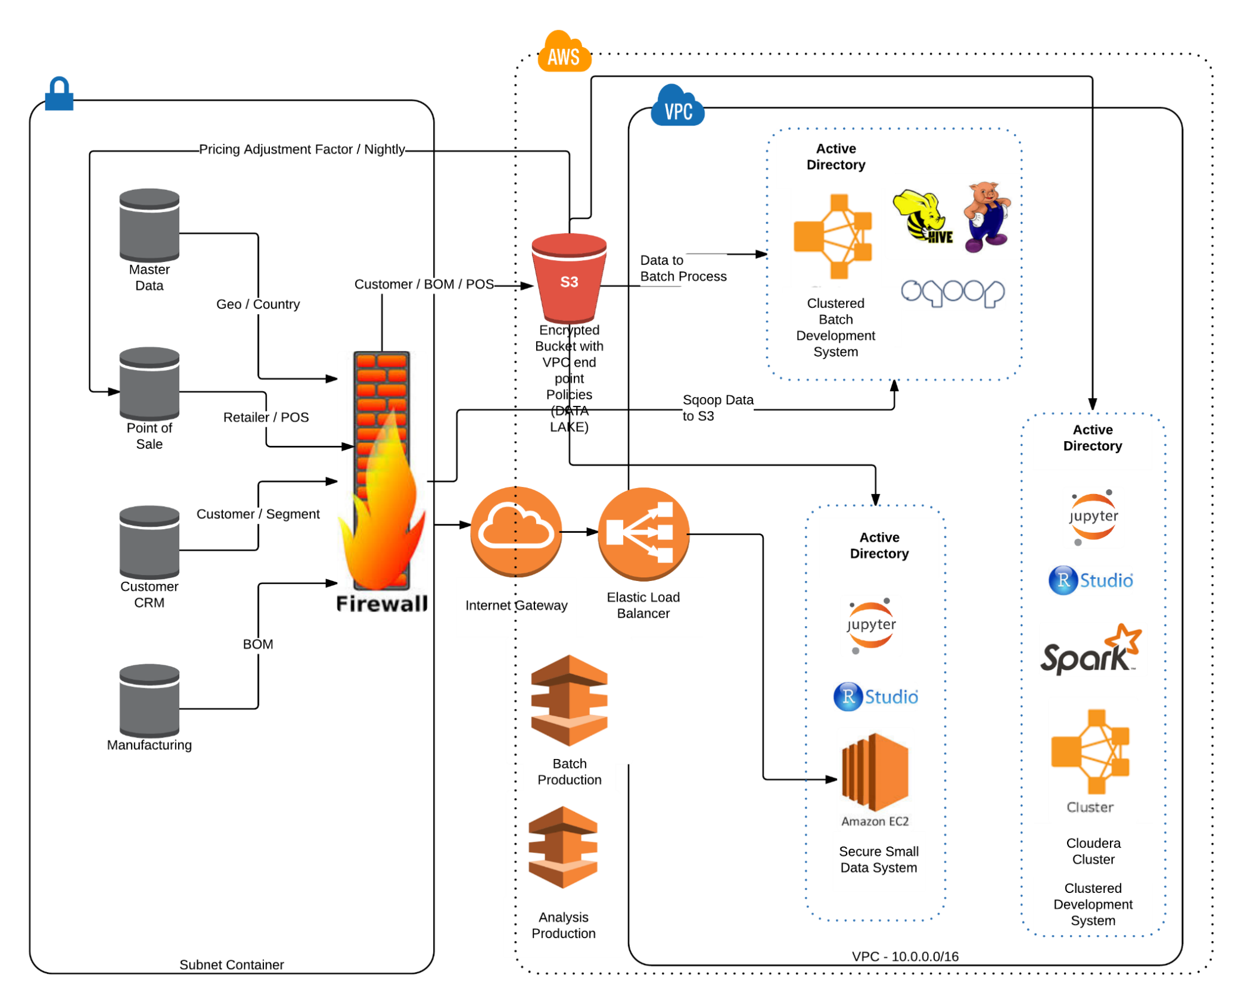
ARCHITECTURE MODEL

Slide 85
